Slide 1
Cardiovascular Health Disease Project
Prepared by:
Tasneem Hossam 2301321
Basant Gamal Lamey 2301331
Marina Ayman Asaad 2301310
Eman Abdelbaset Abdlftah 2300825
Rana Rezk Lotfy 2301304
Supervised by:
Dr. Wafaa Samy Eng. Elmohanad Alaa Eldeen

Slide 2
Idea Description:
Cardiovascular diseases are one of the leading causes of death worldwide. In this project, we aim to build machine learning models to predict whether a person has cardiovascular disease based on medical and lifestyle features. The dataset contains information such as age, blood pressure, cholesterol, weight, and physical activity.

Slide 3
Dataset Description:
The dataset used contains more than 30,000 records with multiple features and contains health and lifestyle information for adults such as age, blood pressure, cholesterol, weight, smoking, alcohol use, and physical activity. The target variable cardio indicates whether a person has cardiovascular disease (0 = no, 1 = yes). Machine learning classification models will be used to predict cardiovascular disease

Slide 4
Data Preprocessing:
Check of Balanced
df['cardio'].value_counts()
2. Handled missing values
print(df.isnull().sum())
3. Removed unnecessary columns
df.drop(columns=['Unnamed:0'],inplace=True)
df.drop(columns=['id'],inplace=True)
4. Converted age from days to years
df['age'] = (df['age'] / 365)

Slide 5
5. unrealistic values using medFilteredical logic
df = df[(df['ap_hi'] > 60) & (df['ap_hi'] < 250)]
df = df[(df['ap_lo'] > 40) & (df['ap_lo'] < 180)]
df = df[df['ap_hi'] > df['ap_lo’]]
df = df[(df['height'] > 100) & (df['height'] < 220)]
df = df[(df['weight'] > 30) & (df['weight'] < 200)]
6. Handled outliers using IQR method with clipping
cols_to_cap = ['ap_hi', 'ap_lo', 'height', 'weight']
for col in cols_to_cap:
Q1 = df[col].quantile(0.25)
Q3 = df[col].quantile(0.75)
IQR = Q3 - Q1
lower = Q1 - 1.5 * IQR
upper = Q3 + 1.5 * IQR
df[col] = df[col].clip(lower=lower, upper=upper)

Slide 6
7. Check and removed duplicate rows
Check :
print("Duplicated rows:", df.duplicated().sum())
df.drop_duplicates(inplace=True)
Remove :
8. Created a new feature (BMI)
df['BMI'] = df['weight'] / ((df['height'] / 100) ** 2)
df['BMI'] = df['BMI']

Slide 7
Feature Scaling :
We used StandardScaler to normalize the data.
from sklearn.preprocessing import StandardScaler scaler = StandardScaler() X_train_scaled = scaler.fit_transform(X_train) X_test_scaled = scaler.transform(X_test)

Slide 8
Data Splitting
- Data was split into training (80%) and testing (20%) sets - Stratified sampling was used X_train, X_test, y_train, y_test = train_test_split(
X, y,
test_size=0.2,
random_state=42,
stratify=y
)

Slide 9
Dimension Reduction

Slide 10
Feature Selection :
Selecting the most important features to improve performance.
selector = SelectKBest(score_func=f_classif, k=7)
X_train_selected = selector.fit_transform(X_train_scaled, y_train)
X_test_selected = selector.transform(X_test_scaled)
scores_df = pd.DataFrame({
'Feature': X.columns,
'Score' : selector.scores_,
'Selected': selector.get_support()
}).sort_values('Score', ascending=False)

Slide 11
Feature Extraction(PCA) :
PCA was applied to reduce dimensionality while preserving 95% of the data variance.
pca = PCA(n_components=0.95, random_state=42)
X_train_pca = pca.fit_transform(X_train_scaled)
X_test_pca = pca.transform(X_test_scaled)
print(f'Number of original features : {X_train_scaled.shape[1]}’)
print(f'Number of components after PCA : {X_train_pca.shape[1]}’)
print(f'Explained information retained : {pca.explained_variance_ratio_.sum()*100:.1f}%’)

Slide 12
Modeling :
We used three machine learning models: Decision Tree Random Forest K-Nearest Neighbors (KNN)
def train_and_evaluate(model_name, model, X_tr, X_te, y_tr, y_te):
model.fit(X_tr, y_tr)
y_pred = model.predict(X_te)
acc = accuracy_score(y_te, y_pred)
return acc
models = {
"Decision Tree": DecisionTreeClassifier(random_state=42),
"Random Forest": RandomForestClassifier(random_state=42),
"KNN": KNeighborsClassifier()
}

Slide 13
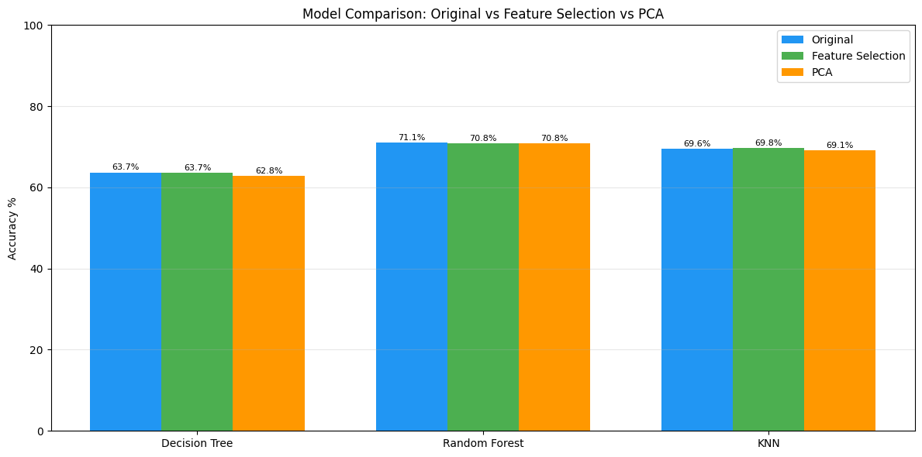
Model Comparison
- Feature Selection improved performance slightly. - PCA reduced dimensionality with minimal accuracy loss. - Random Forest achieved the best results.

Slide 14
Thank You

